Slide 1

Impact of Stress Management on Workforce Productivity
Group No: 04
Student Names: Praveen Jayasankar & Saanthakumaran Mohanasundaram

Slide 2

INTRODUCTION
Recently, we could find field of analytics is growing in HR system called People analytics.
People Analytics is deeply data driven and goal-focused method of studying all people processes, functions, challenges, and opportunities at work to elevate these systems and achieve business success.
So, we are dealing with the specific case where mental health of workforce is considered, to determine the performance of the labors and resultant productivity for the company.

Slide 3
BUSINESS PROBLEM DEFINITION
Nowadays, Labors are not only facing physical stress but also mental stress.
There are a lot of factors contributing to it. So, in the recent times taking care of the mental health of the workforce is also one of the prime responsibilities of the HR department.
HR department measures the productivity of the labors and if found to be less productive, the factors contributing to their low productivity is also determined.
So, to take care of the their mental health, the company employs psychologist.
The psychologists have counselling sessions with the labors to determine and treat their mental ailments.
The database consists of employee details – HRs and supervisors, labor details, psychologist details and the details on the consultations and feedbacks.

Slide 4
GOAL OF THE STUDY
To design a Relational Database for the application of workforce analytics with additional information of consultations from Psychologists.
To access the database created in MySQL via R to perform simple analytics.
To determine the reason behind the low performance and measure the labor productivity cost based on the improvement of their mental health.
This model can be easily accessible by top level executives to determine the current status of the labor and their productivity.
This model is transparent among the departments i.e. reports given by the psychologists can be accessed by the HR department to check the productivity of each labor and by the psychologists to provide feedback after each session.

Slide 5
REQUIREMENTS
Information on Labor details like their department, performance metrics (Goal achieved, engagement, respect, etc) as well as their medical history (sleep hours, family history, appetite, medication) are needed
Also, we have details of various department employees like HR, Shop floor supervisor and Psychologist also are required.

Slide 6
CONCEPTUAL DATA MODELING

Slide 7
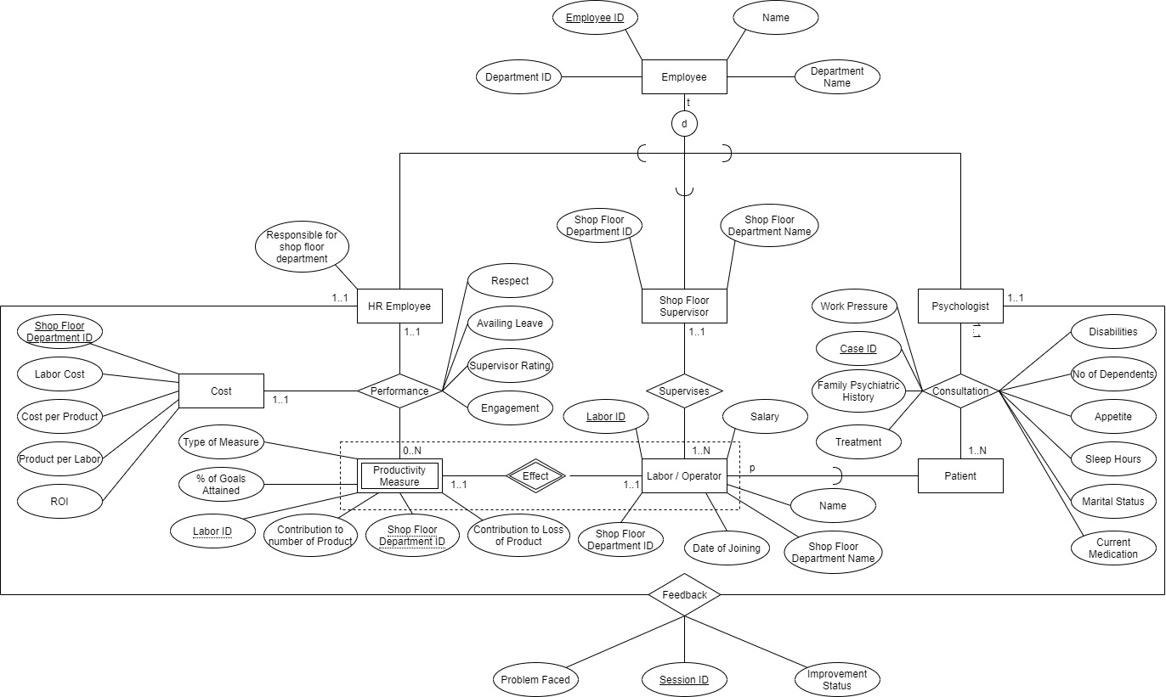
EER Model
Semantics Lost
Since we are having many attributes like cost per labor, Product per labor, and ROI (Return of Investment), we can’t do calculations in EER form
We can’t specify cost values to be always positive.
Temporal constraints like resignation or hiring new labor/operator cannot be accounted.

Slide 8
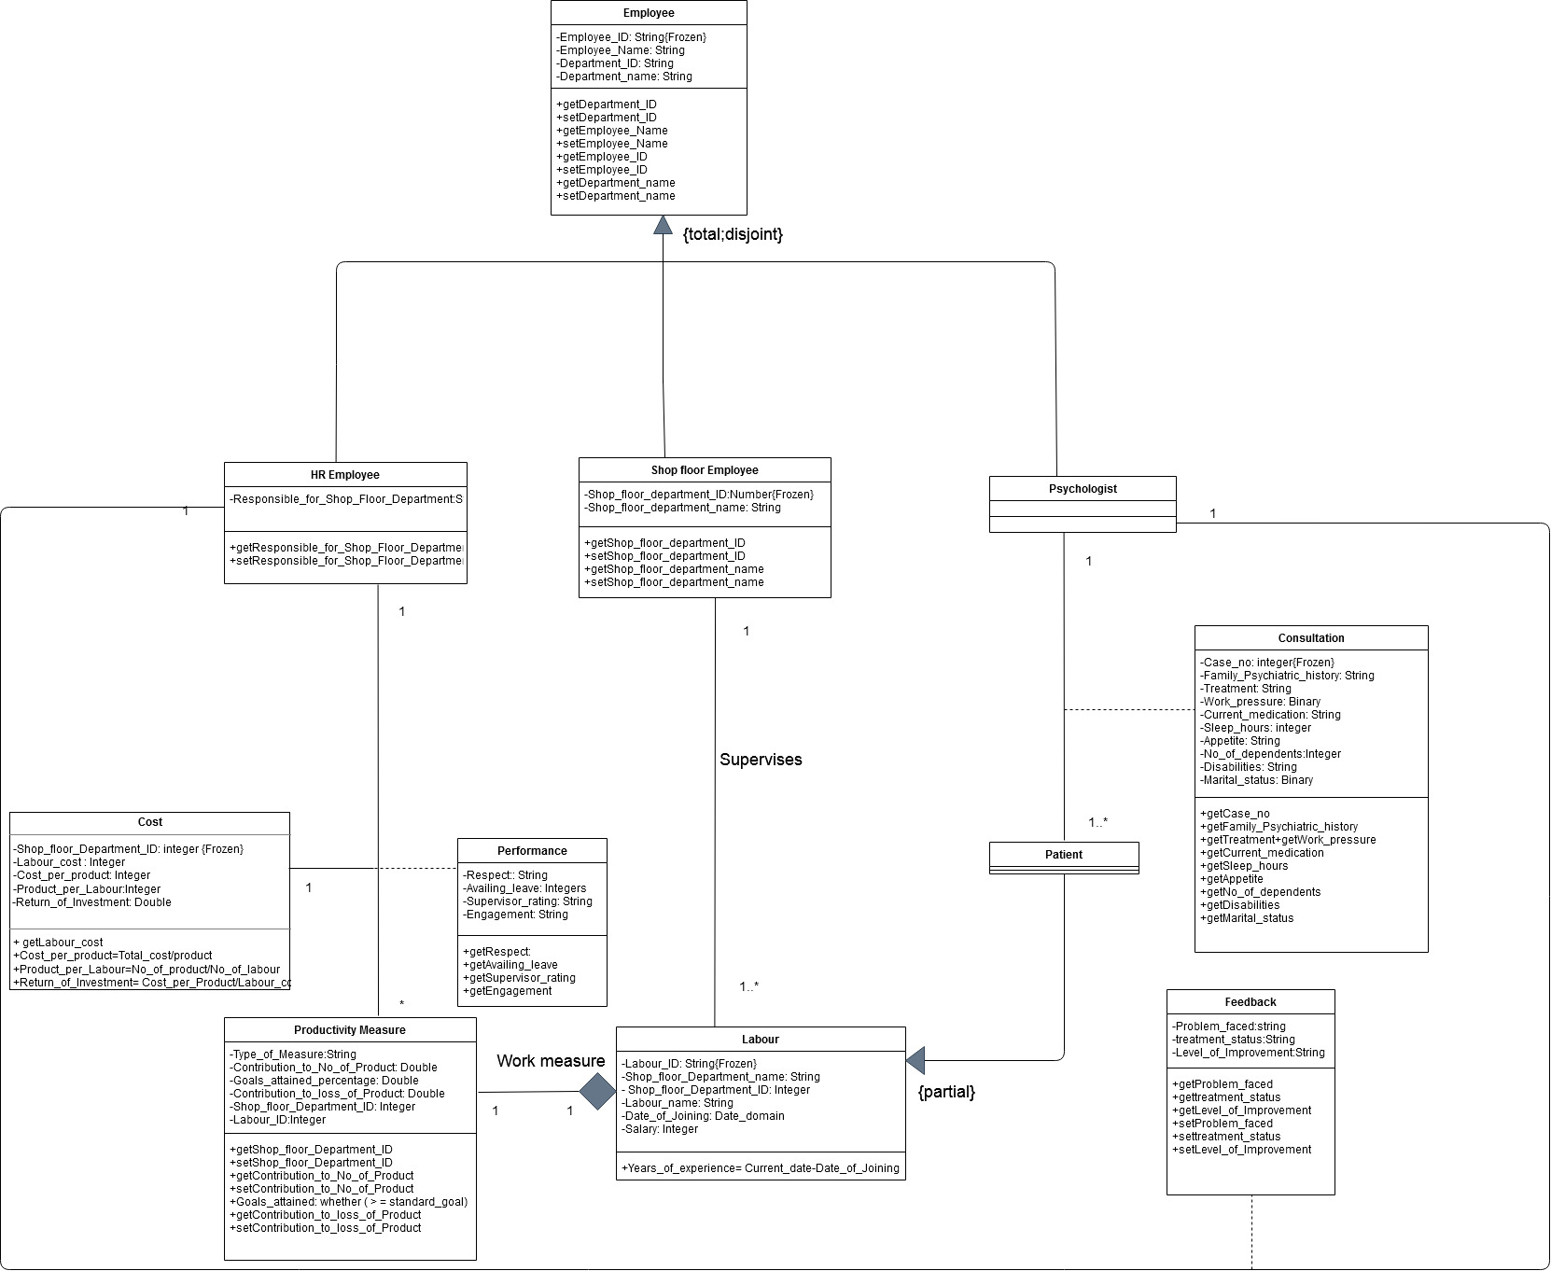
CONCEPTUAL UML CLASS DIAGRAM
OCL Constraints
Context: Labour
Invariant: Salary >$500
Context: Cost
Invariant: Cost_per_product>0
Invariant: Product_per_labor>0
Invariant: ROI >0

Slide 9
Mapping of Conceptual Data Model into Relational Model
EMPLOYEE (Employee_ID , Name, Department_ID)
• Department_ID is a Foreign key referring to Department_ID in Department_Name; Null Not allowed, on delete/update cascade.
DEPARTMENT_NAME (Department_ID, Department_Name)
HR_EMPLOYEE (Employee_ID, Responsible_for_shop_floor_Department)
• Employee_ID is a Foreign key referring to Employee_ID in Employee; Null Not allowed, on delete/update cascade.
• Responsible_for_shop_floor_Department is a Foreign key referring to Shop_floor_Department_ID in Shop_Floor_Department; Null Not allowed, on delete/update cascade.
SHOP_FLOOR_SUPERVISOR (Shop_floor_Supervisor_ID, Shop_Floor_Department_ID)
• Shop_floor_Supervisor_ID is a Foreign key referring to Employee_ID in Employee; Null Not allowed, on delete/update cascade.
• Shop_Floor_Department_ID is a Foreign key referring to Shop_Floor_Department_ID in Shop_Floor_Department; Null Not allowed, on delete/update cascade.
SHOP FLOOR DEPARTMENT (Shop_Floor_Department_ID , Shop_Floor_Department_name)
PSYCHOLOGIST (Psychologist_ID)
• Psychologist_ID is a Foreign key referring to Employee_ID in Employee; Null Not allowed, on delete/update cascade.
LABOUR (Labour_ID, Name, Supervisor_ID, Salary, Floor_Department_ID, Date_of_joining)
• Supervisor_ID is a Foreign key referring to Shop_Floor_Supervisor_ID in Shop_floor_Supervisor; Null Not allowed, on delete/update cascade.
• Floor_Department_ID is a Foreign key referring to Shop_Floor_Department_ID in Shop_Floor_Department; Null Not allowed, on delete/update cascade.
PATIENT (Patient_ID)
• Patient_ID is a Foreign key referring to Labour_ID in Labour; Null Not allowed, on delete/update cascade.

Slide 10
Mapping of Conceptual Data Model into Relational Model cont. Semantics lost The disjointness of the specialization of Employee into HR, Shop floor supervisor and Psychologist cannot be enforced.
CONSULTATION (Case_ID, Patient, Pyschologist_Employee_ID, work_pressure, Family_Psychiatric_history, Treatment, Disabilities, No_of_dependents, Appetite, Sleep_hours, Marital_status, Current_medication)
• Patient is a Foreign key referring to Patient_ID in Patient; Null Not allowed, on delete/update cascade.
• Psychologist_Employee_ID key referring to Psychologist_ID in Psychologist; Null Not allowed, on delete/update cascade.
FEEDBACK (Session_ID, Psychologist, HR_Employee_ID, Problem_faced, Improvement_status)
• Psychologist is a Foreign key referring to Psychologist_ID in Psychologist; Null Not allowed, on delete/update cascade.
• HR_Employee_ID is a Foreign key referring to Employee_ID in HR_Employee; Null Not allowed, on delete/update cascade.
PRODUCTIVITY MEASURE (Labour_ID, Type_of_Measure, Goals_attained_percentage, Contribution_to_Number_of_product, Contribution_to_loss_of_product)
• Labour_ID is a Foreign key referring to Labour_ID in Labour; Null Not allowed, on delete/update cascade.
PERFORMANCE (Labour, HR_Employee, Shop_Floor_Department, Respect, Availing_leave, Supervisor_Rating, Engagement)
• Labour is a Foreign key referring to Labour_ID in Labour; Null Not allowed, on delete/update cascade.
• HR_Employee is a Foreign key referring to Employee_ID in HR_Employee; Null Not allowed, on delete/update cascade.
• Shop_Floor_Department is a Foreign key referring to Shop_Floor_Department_ID in Shop_Floor_Department; Null Not allowed, on delete/update cascade.
COST (Floor_Department, Labour_Cost, Cost_per_product, Product_per_labour, ROI)
• Floor_Department is a Foreign key referring to Shop_Floor_Department_ID in Shop_Floor_Department; Null Not allowed, on delete/update cascade.

Slide 11
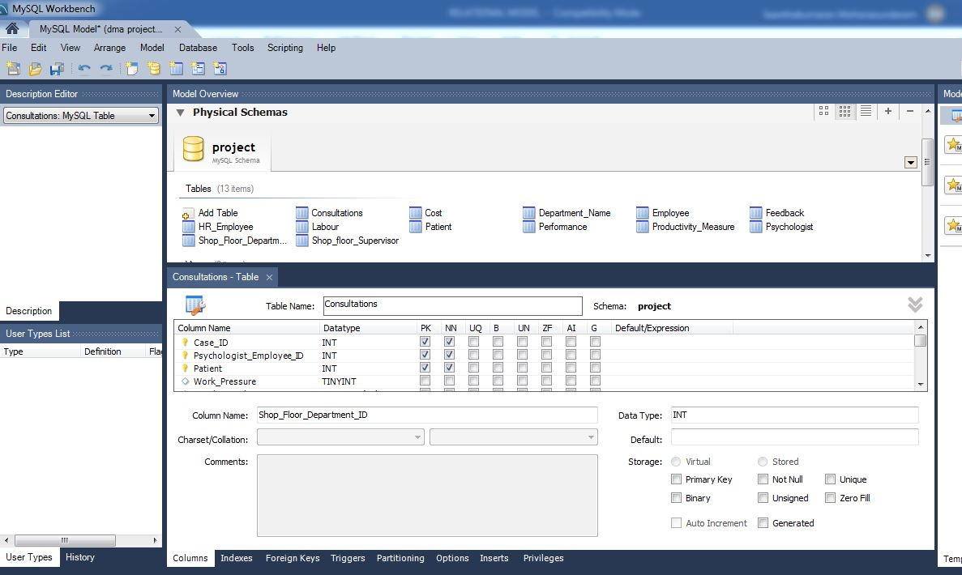
IMPLEMENTATION USING MYSQL
1. Created a model with schema named “Project” and created tables with primary key, foreign keys with relations mentioned.
2. Assigned datatype to each column name and constraints declared.

Slide 12
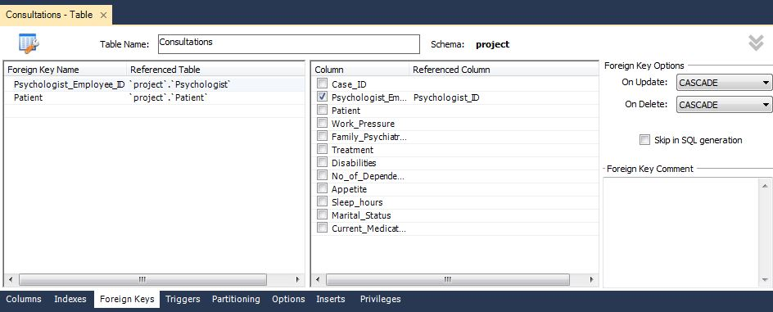
3. Foreign keys were referred to appropriate keys in reference table.

Slide 13
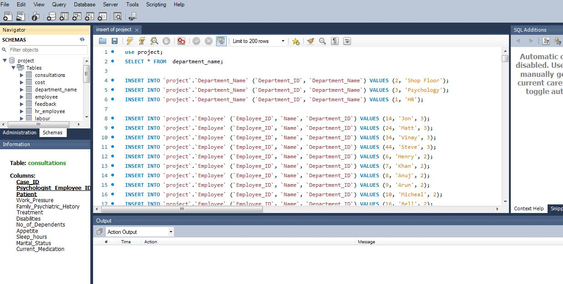
4. After loading the created schema ‘PROJECT’ into the local host using Forward Engineer. We are loading the tables with data using INSERT Statement.

Slide 14
5. After loading the data, we run a sample query to find the” No of patients who are taken care by matt and their average sleep hours”

Slide 15
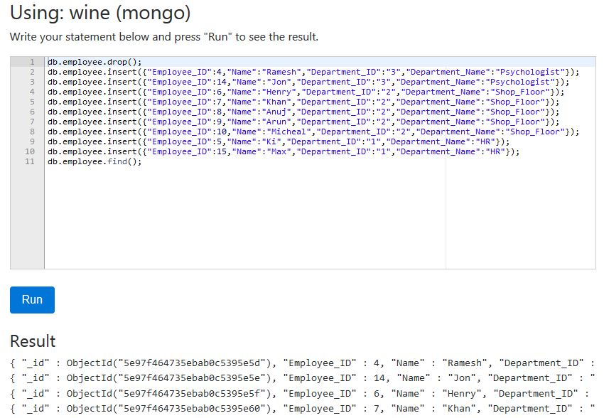
IMPLEMENTATION OF RELATIONAL MODEL IN NOSQL: MONGODB
1. Creating the Employee table in MongoDB with 10 records.

Slide 16
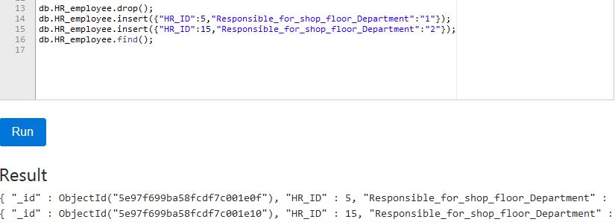
2. HR_employee table is added

Slide 17
3. Retrieving the count of employees per department

Slide 18
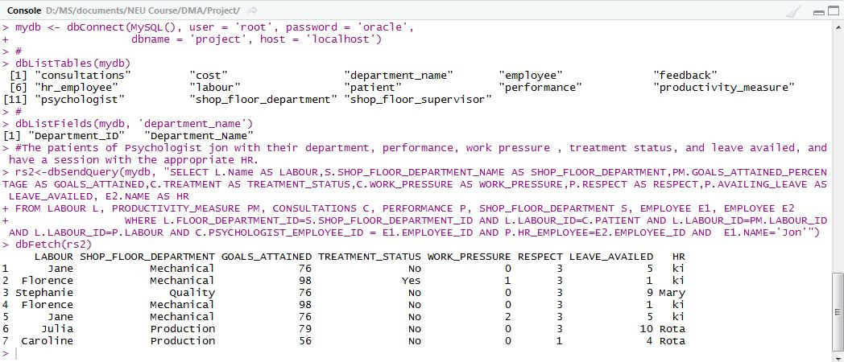
DATABASE ACCESS VIA R OR PYTHON
By accessing the DB ‘Project’ in R, we did a query of retrieving “the patients of Psychologist “jon” with their department, performance, work pressure, treatment status, leave availed, and appropriate HR” planning to have a session with the HR.

Slide 19
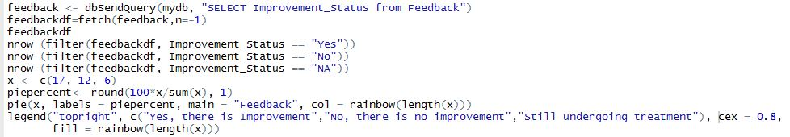
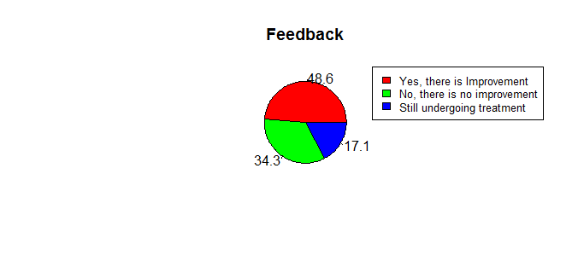
ANALYTICS PERFORMED USING R
From the pie chart we can infer that 48.6% of the labors have improvement in their productivity after the treatment, as opposed by the 34.3% of labors who are have not shown any increase in productivity after the treatment, whereas the rest 17.1% of the labors are still undergoing treatment.

Slide 20

EXECUTIVE SUMMARY
• We designed the EER, UML model for the people analytics database with all appropriate entity, attributes and relations with all cardinalities specified.
• We mapped the Conceptual model to Relational model and did normalization for the tables so that it satisfies 3N.
• Then primary keys, Foreign keys along with constraints were specified for each relation.
• With the relation model constructed, we could create the database using MySQL with all the required tables under the schema “Project” and we could find few insights on the data through few sample queries.
• We also implemented few tables in NoSQL (MongoDB) and was able to do a sample aggregate functions with the elements in the table.
• At the end, we accessed the database created in MySQL in R and achieved in computing few queries and we were able to do simple analytics using R.

Slide 21

Advantages:
• The advantages of using MySQL for this application are we could create a schema where we could do complex queries easily like joining, recursive functions and triggers.
• Since, we could create a schema on write approach, MySQL provides data integrity for analytics purpose.
Disadvantages
• NoSQL for this application won’t be suitable because only simple group by statements through aggregate functions can be executed whereas, we can’t apply join tables, which is very important for analytics purpose.
• Though NoSQL has schema on read approach, which involve less time, there are higher chance of misinterpretation in data type, which could cause problem in manipulation for analytics.
Recommendations
• Since, in this scenario we are dealing with only hundreds and thousands of records and analytics become a crucial role in people analytics domain, we would recommend to use MySQL for creating DB.

Slide 22
THANK YOU!

